Slide 1


Slide 2
Chapter 5
Input Values and Basic Flutter Packages

Slide 3
Contents
Introduction
TextField Widget
Passing data between screens in Flutter
Google Fonts Flutter Package
FontAwesome Flutter Package
BottomNavyBar Package

Slide 4
Introduction
In this lesson, you will learn more about Text fields allow users to type text into an app. They are used to build forms, send messages, create search experiences, and more. Furthermore you will learn passing data between screens in Flutter. In the end you will learn some basic Flutter packages.

Slide 5
TextField Widget
TextField widget is the most commonly used text input widget. By default, a TextField is decorated with an underline. You can add a label, icon, and inline hint text by supplying an InputDecoration as the decoration property of the TextField.

Slide 6
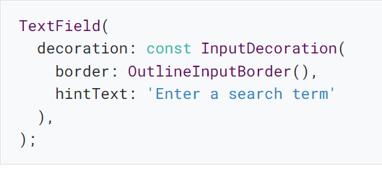
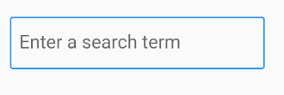
TextField Widget Example

Slide 7
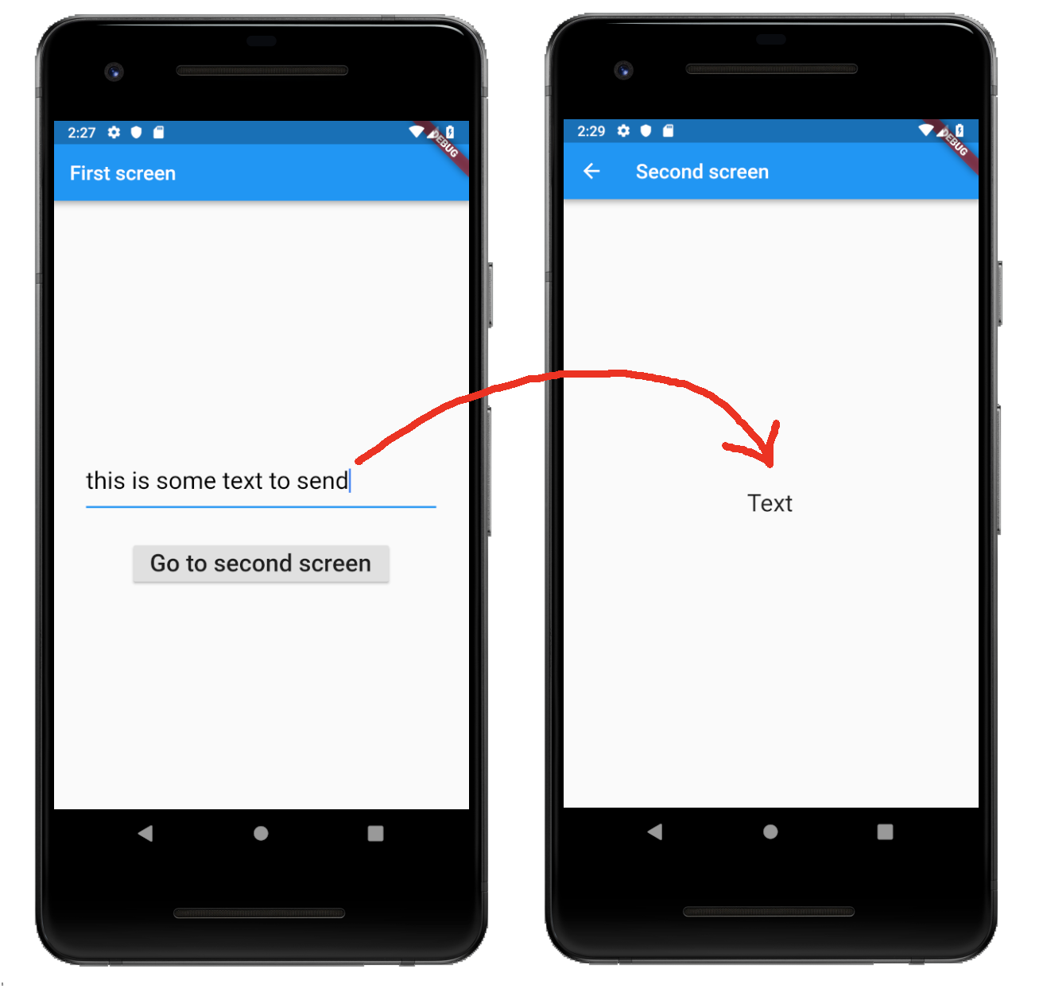
Passing data between screens using TextField

Slide 8
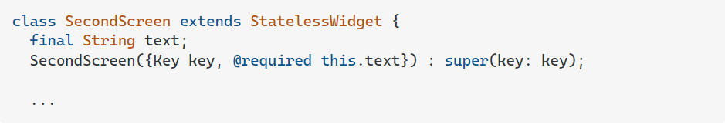
Passing data between screens using TextField
To send data to the next screen follow these steps:
Make the SecondScreen constructor take a parameter for the type of data that you want to send to it. In this particular example, the data is defined to be a String value and is set here with this.text.

Slide 9
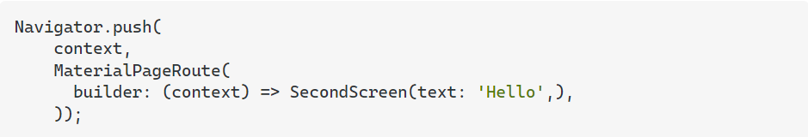
Passing data between screens using TextField
2) Then use the Navigator in the FirstScreen widget to push a route to the SecondScreen widget. You put the data that you want to send as a parameter in its constructor.

Slide 10
google_fonts package for Flutter
The google_fonts package for Flutter allows you to easily use any of the 977 fonts (and their variants) from fonts.google.com in your Flutter app.

Slide 11
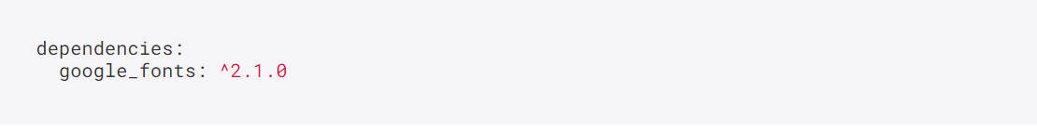
Installing google_fonts package for Flutter
Run this command with flutter
This will add a line like this to your package's pubspec.yaml (and run an implicit flutter pub get):

Slide 12
Installing google_fonts package for Flutter
Now in your Dart code, you can use:

Slide 13
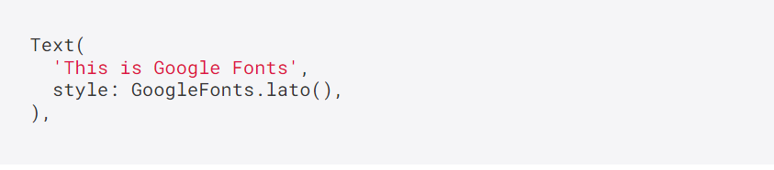
Example google_fonts package for Flutter

Slide 14
font_awesome_flutter package
The Font Awesome Icon pack available as set of Flutter Icons.
Based on Font Awesome 5.15.4. Includes all free icons:
Regular
Solid
Brands

Slide 15
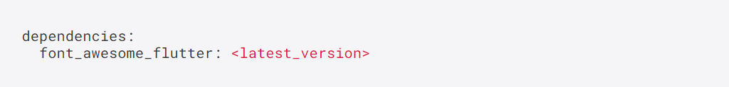
Installing font_awesome_flutter package
In the dependencies: section of your pubspec.yaml, add the following line:

Slide 16
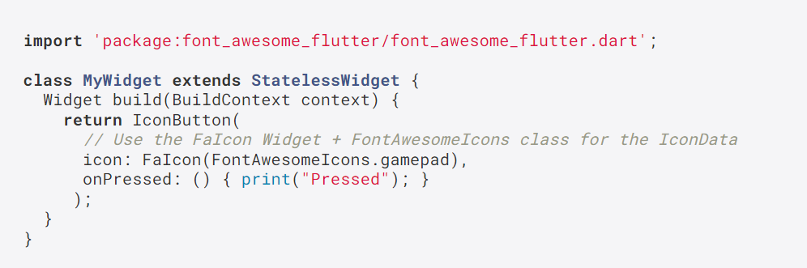
Example font_awesome_flutter package

Slide 17
bottom_navy_bar package
A beautiful and animated bottom navigation. The navigation bar use your current theme, but you are free to customize it.

Slide 18
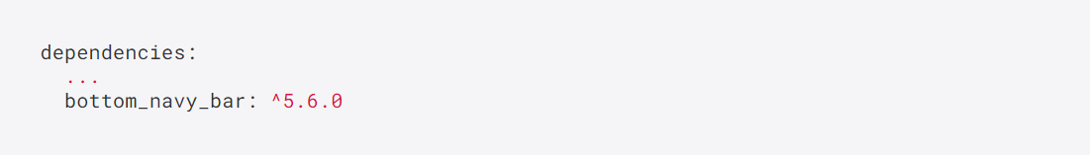
bottom_navy_bar package
Add the dependency in pubspec.yaml:.

Slide 19
BottomNavyBar Customization
iconSize - the item icon's size
items - navigation items, required more than one item and less than six
selectedIndex - the current item index. Use this to change the selected item. Default to zero
onItemSelected - required to listen when a item is tapped it provide the selected item's index
backgroundColor - the navigation bar's background color
showElevation - if false the appBar's elevation will be removed
mainAxisAlignment - use this property to change the horizontal alignment of the items. It is mostly used when you have ony two items and you want to center the items
curve - param to customize the item change's animation
containerHeight - changes the Navigation Bar's height

Slide 20
BottomNavyBarItem
icon - the icon of this item
title - the text that will appear next to the icon when this item is selected
activeColor - the active item's background and text color
inactiveColor - the inactive item's icon color
textAlign - property to change the alignment of the item title

Slide 21
End

